Slide 1

Customer Lifetime Value:
A Case Study on Coach
Group 5: Kevin Ge, Jessie NI, Ayesha Saeed, Tsebaot Shewarega, Edmund Wong, Nathan Yoo, Stella Zhang

Slide 2
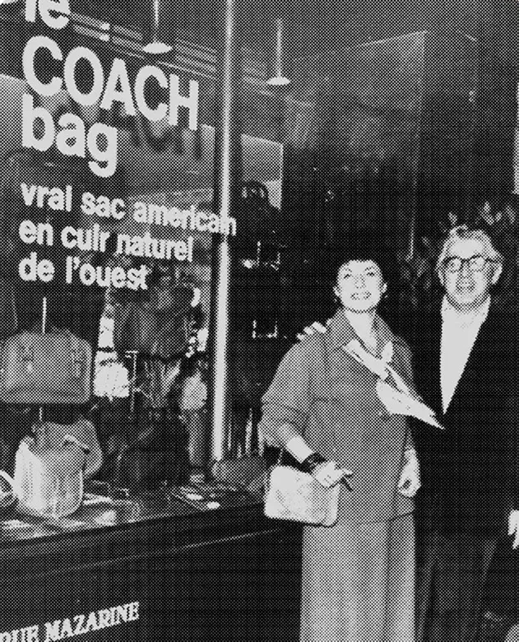
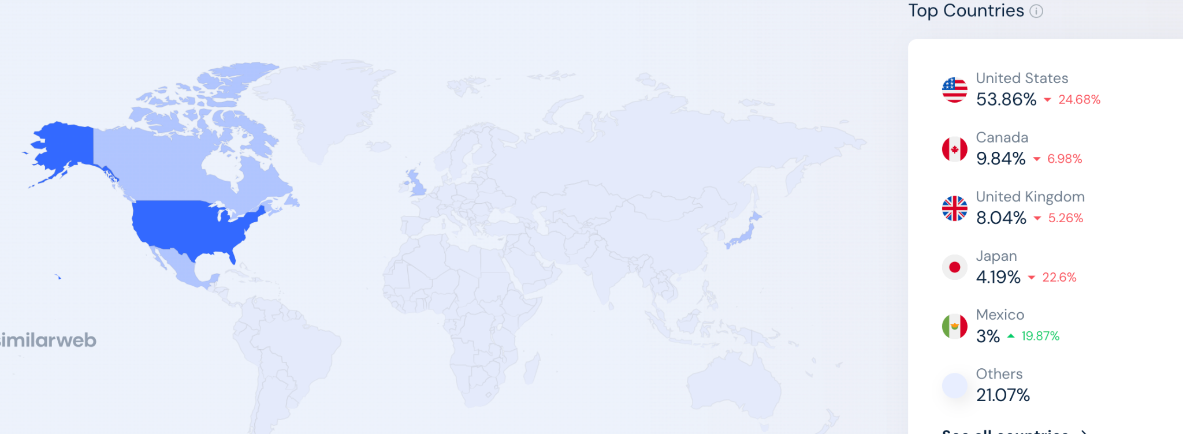
Introduction
Coach since 1941
Affordable Luxury
Classic American Style
Mid-premium pricing strategy
Biggest market in U.S. and Canada (60%)
https://www.similarweb.com/website/coach.com
Notes:
https://www.similarweb.com/website/coach.com/#geography

Slide 3
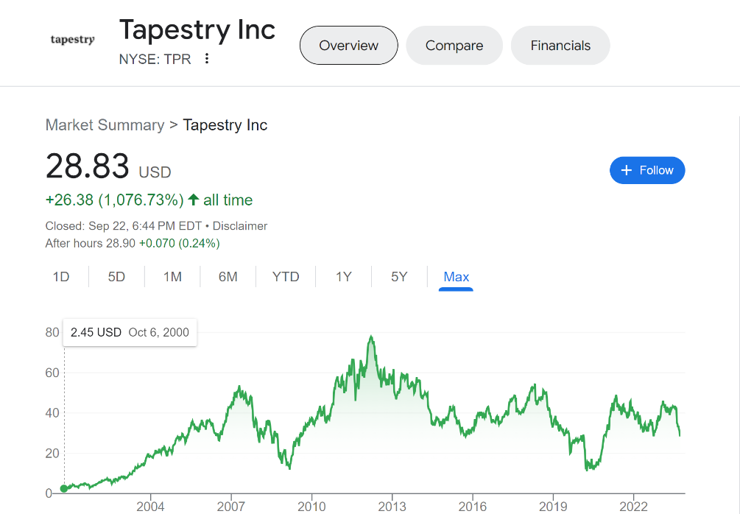
Business Strategies 2017-2019
Coach, Inc. acquired Kate Spade & Company
Change in branding strategy:
Affordable Luxury → Modern Luxury
Reduce discount pricing
Customerization services
Coach X Selena Gomez
Increase in stock price
From: yahoo finance
Notes:
https://www.similarweb.com/website/coach.com/#geography

Slide 4
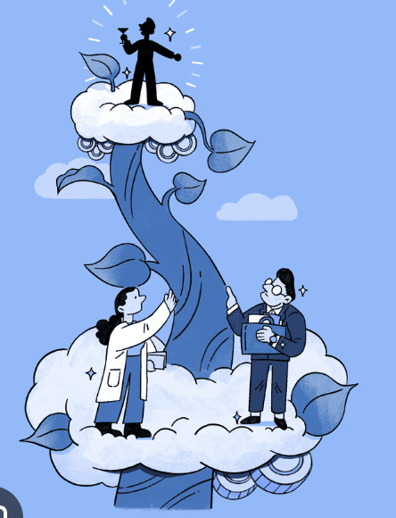
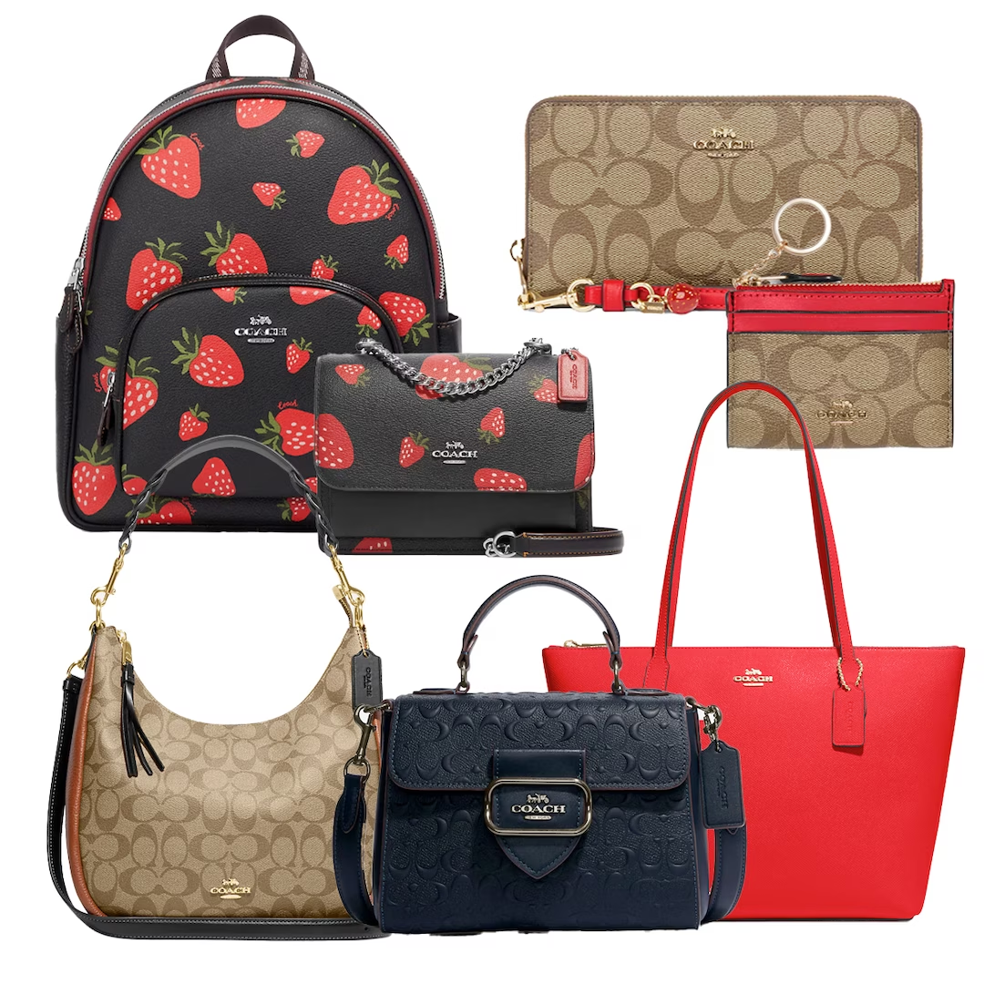
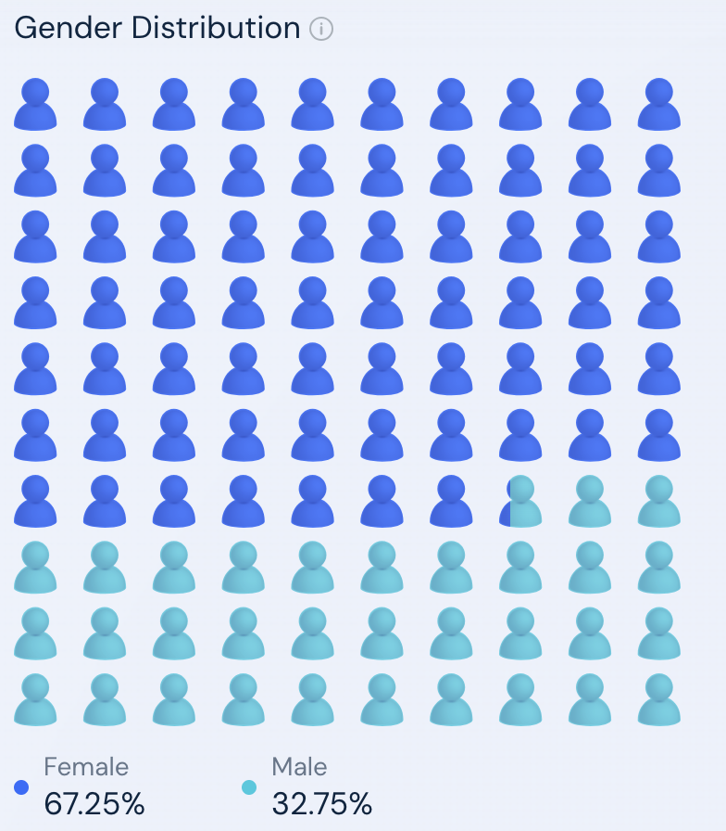
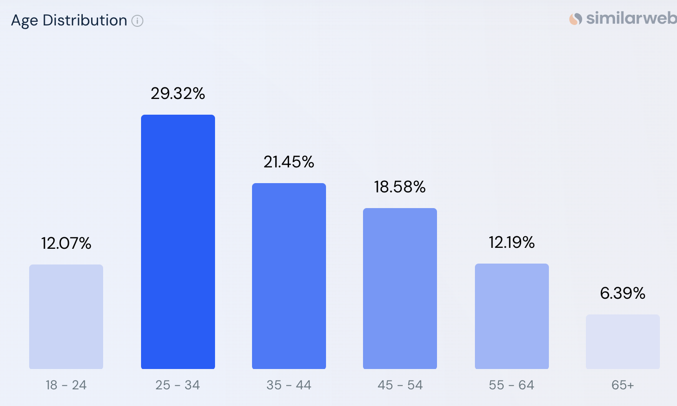
Current Customer Profile
20-45 years old male and female
Medium-high disposable income
HENRYs
(High Income Not Rich Yet)
Aspirational luxury shoppers
Occasional luxury buyers
Designer wannabes
Relatively low brand loyalty
Notes:
https://www.similarweb.com/website/coach.com/#geography

Slide 5

Business Question
Q: Should Coach launch a demi-brand to unlock new customers to begin their life cycle journeys?

Slide 6
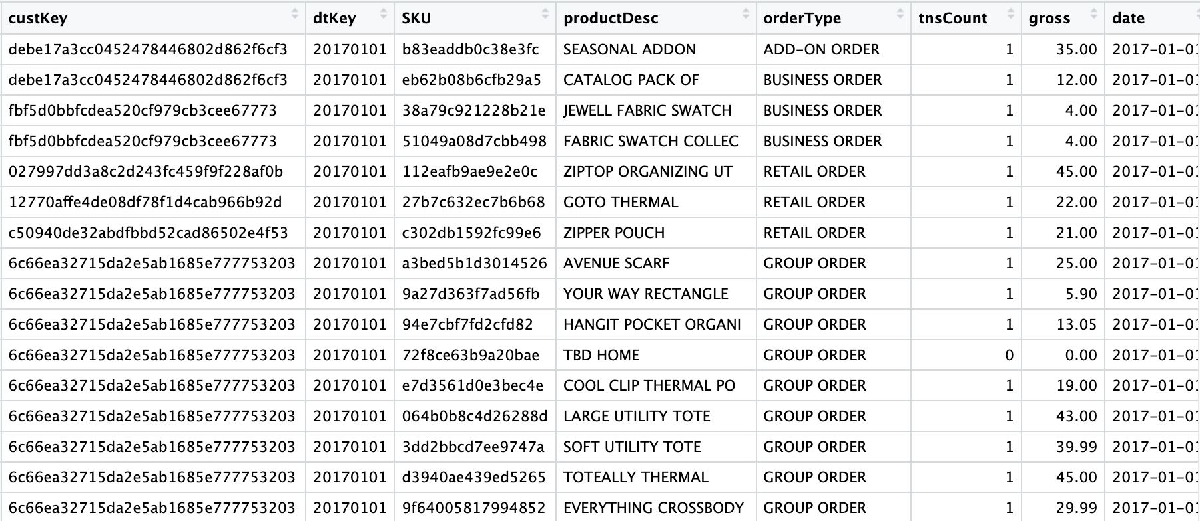
Data & Methods
Descriptive Stats:
"141,154" unique customer id
Mean gross: 20.1
Dates: 01/01/2017 to 03/29/2019
Order types: 8 types
Notes:
Just touching on the ones that are relevant to our studies
Mean gross:
The 8 order types
Add-on order, business order, group order, influencer order, promotional order, retail order, return order, and unknown

Slide 7
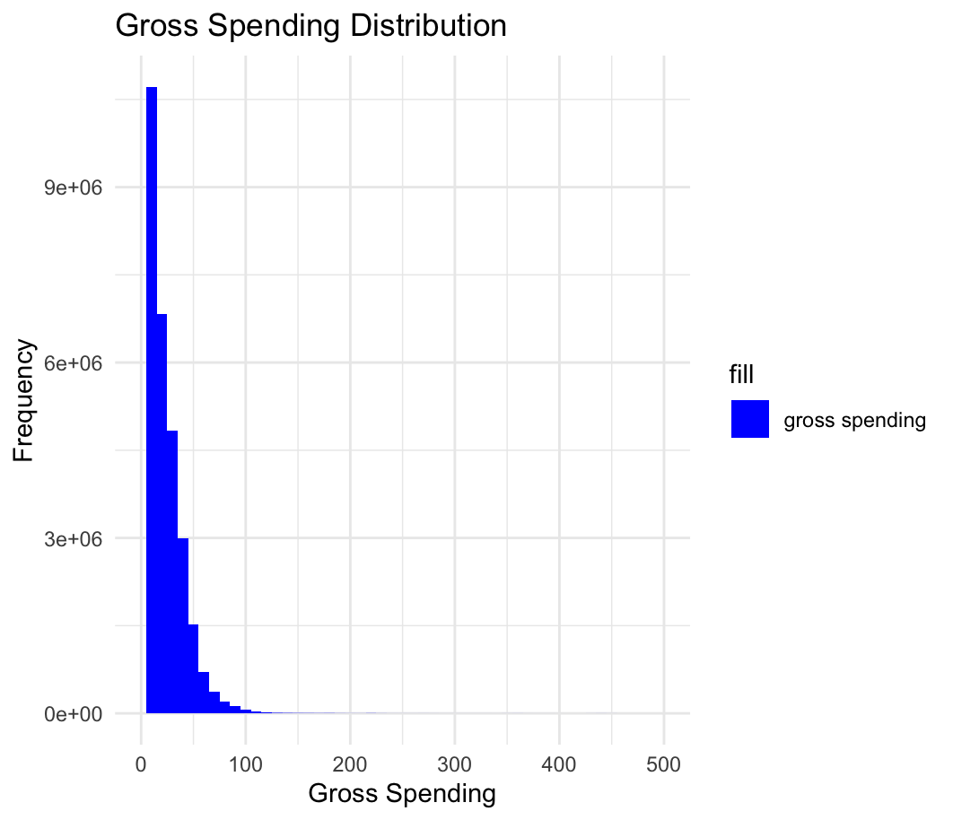
Gross Purchase Price
Notes:
Aggregated on custkey and did a sum of gross
It is very skewed so it gives evidence that this is a dataset for down-market customers (most are spending below

Slide 8
Data & Methods: Pseudo-Churn Model
Pr(Churn)
Frequency
Recency
Monetary
A predictive model that estimates:
for each customer at any given time,
how high the risk is of “churning” them in the future.

Slide 9
Data & Methods: Pseudo-Churn Model
Customer Lifetime Value
Purchase Amount
# Purchases per Period
Lifetime Periods

Slide 10
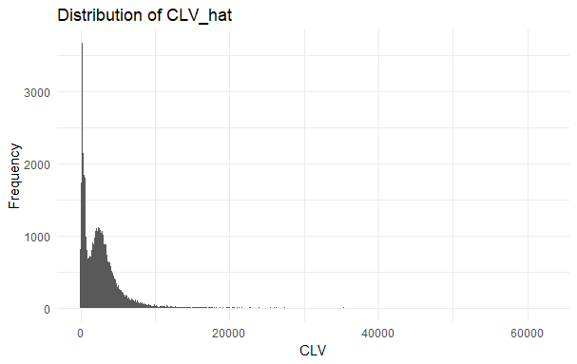
CLV Distribution
CLV hat - prediction of CLV
X-axis - value in dollars
Y-axis - number of customers

Slide 11
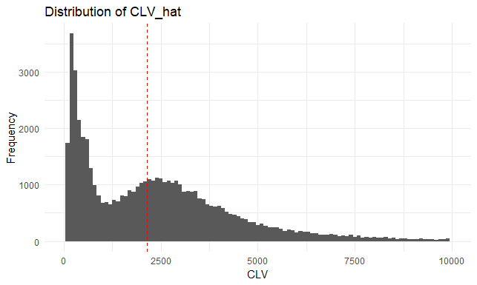
CLV Distribution
CLV hat - prediction of CLV
X-axis - value in dollars
Y-axis - number of customers
*Median = 2137.057
Notes:
Mean: 2581.588
Medium: 2137.057

Slide 12
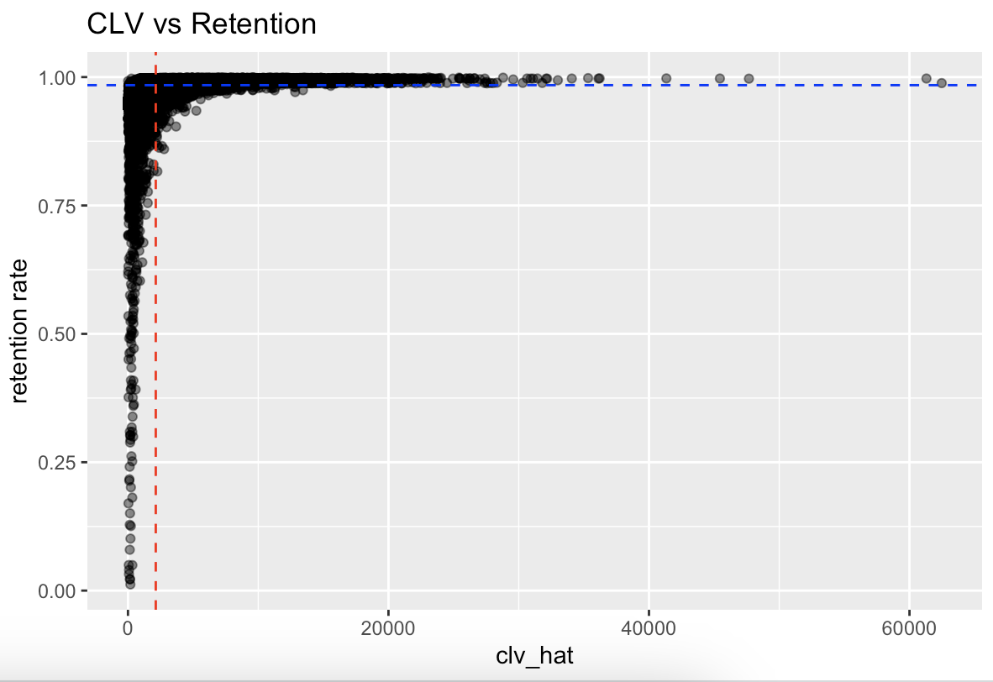
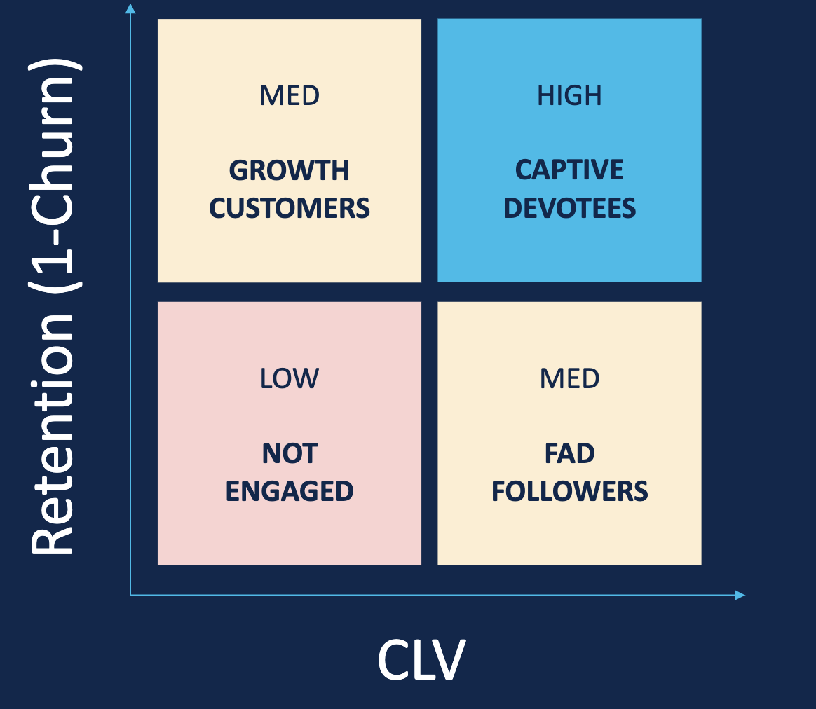
Customer Segmentation
Median_clv：2132.201
Median_retention：0.9843035

Slide 13
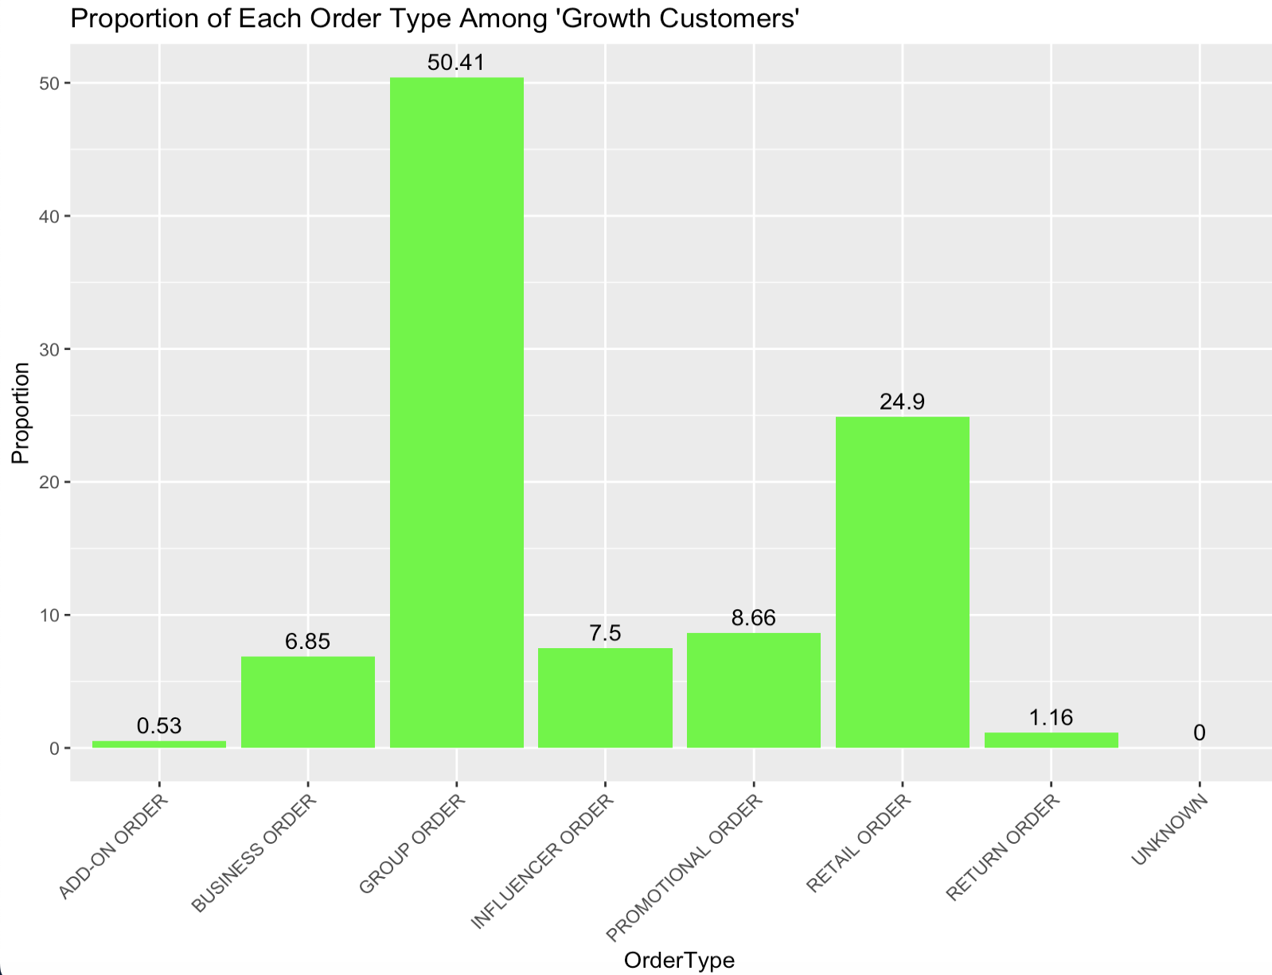
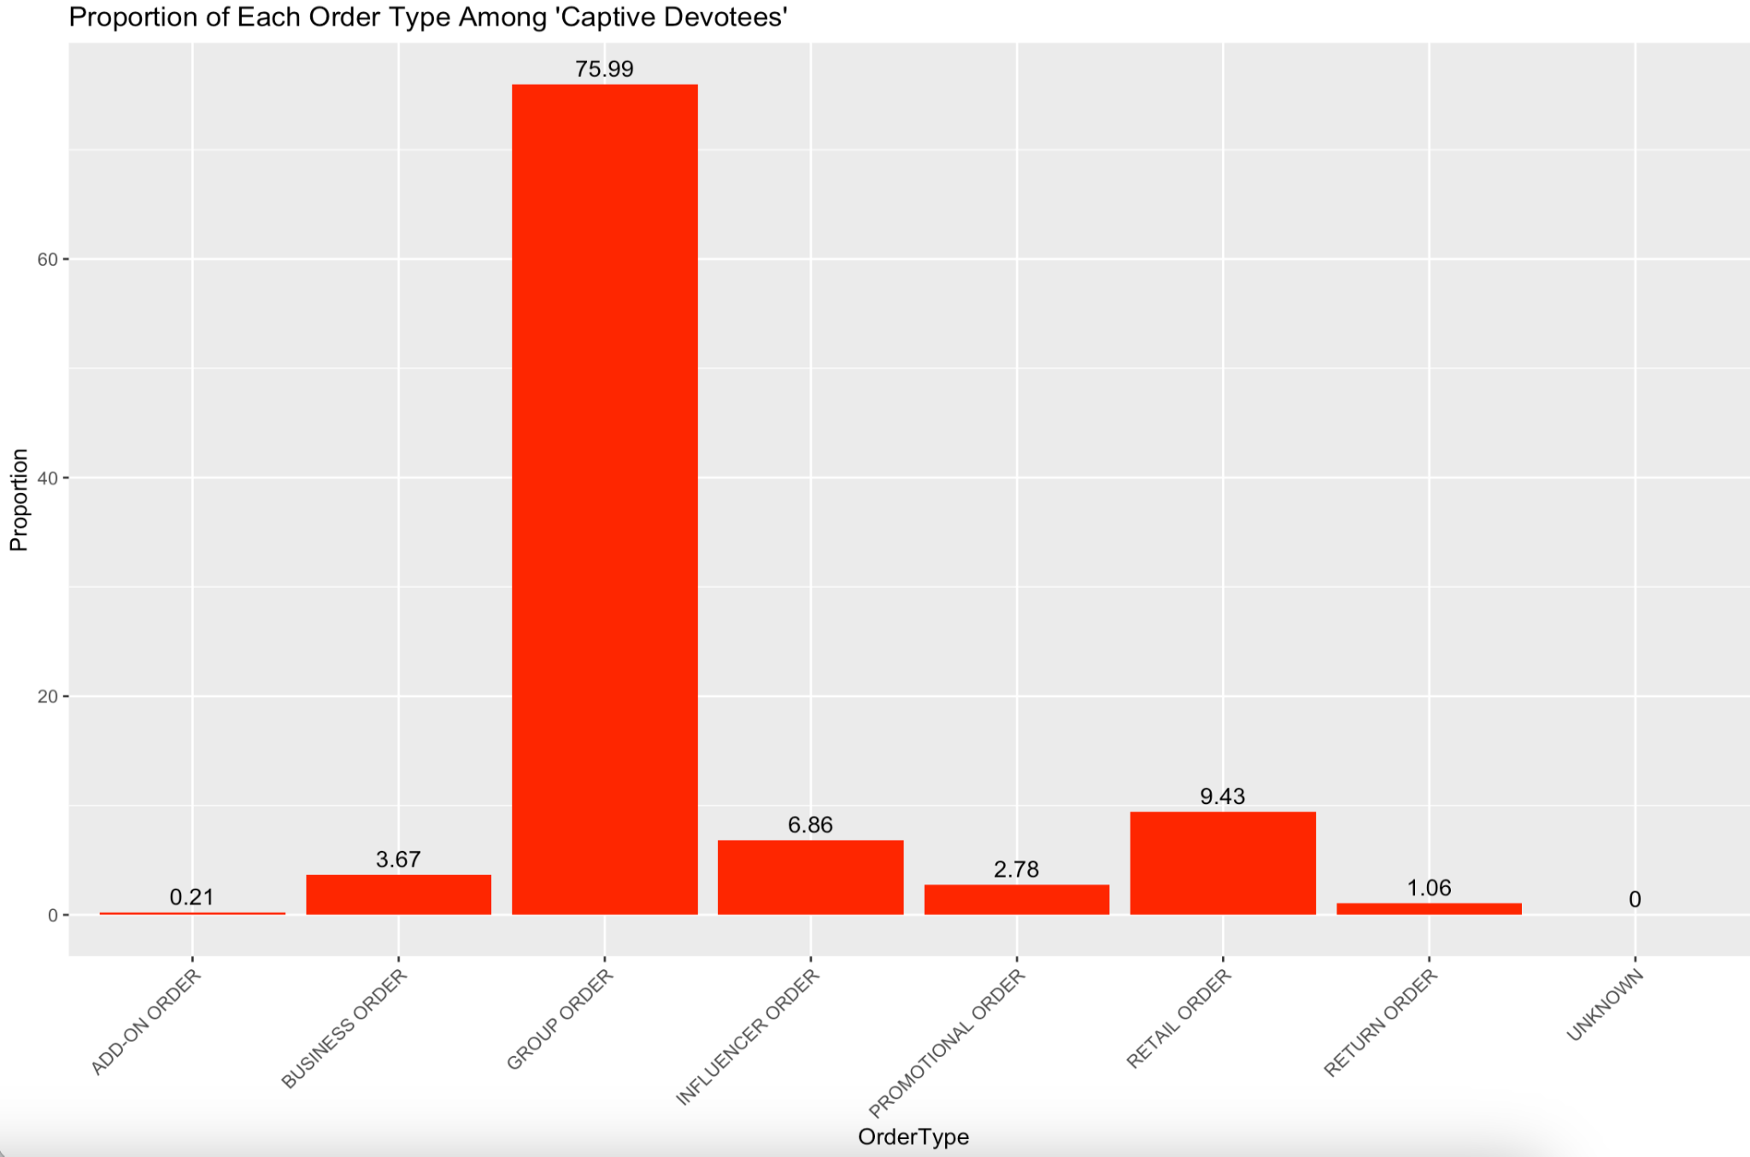
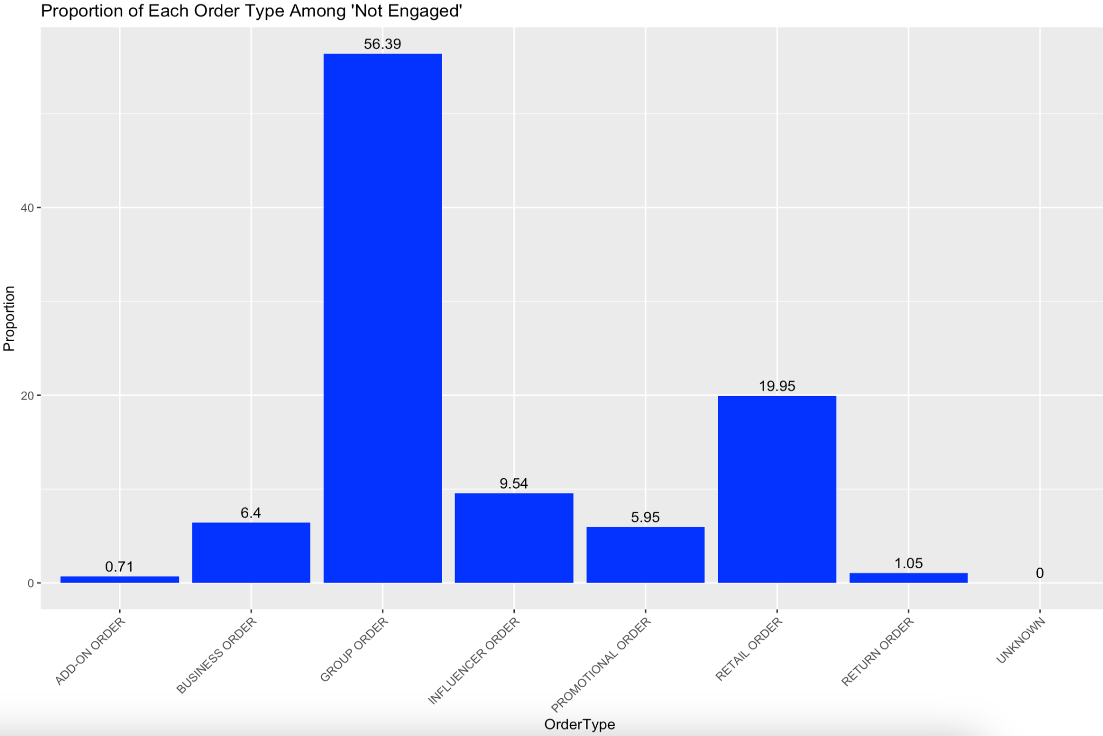
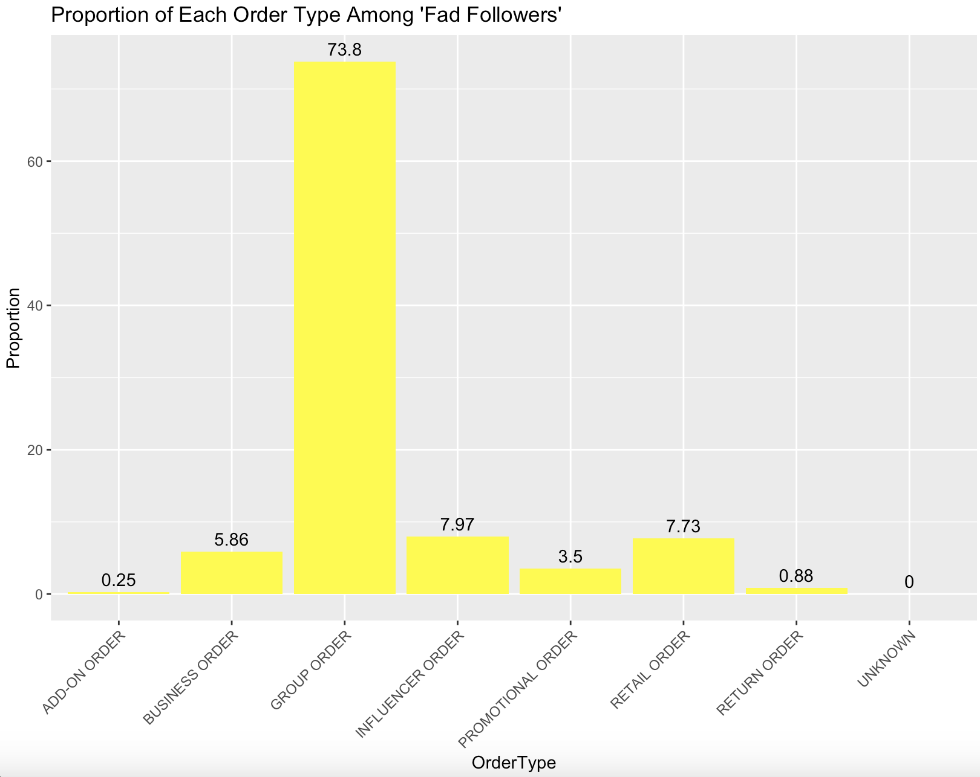
Customer Segmentation: Order Type
Growth Customers
Captive Devotee
Not Engaged
Fad Followers
Notes:
More nuanced insights into the different segments of the customer bases
Fad followers the influencer order tis the highest

Slide 14
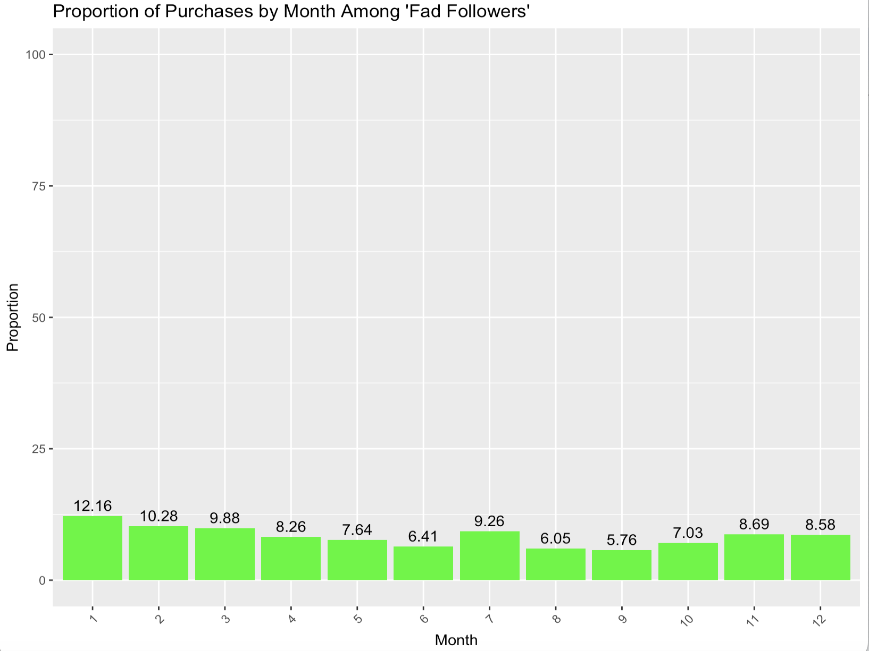
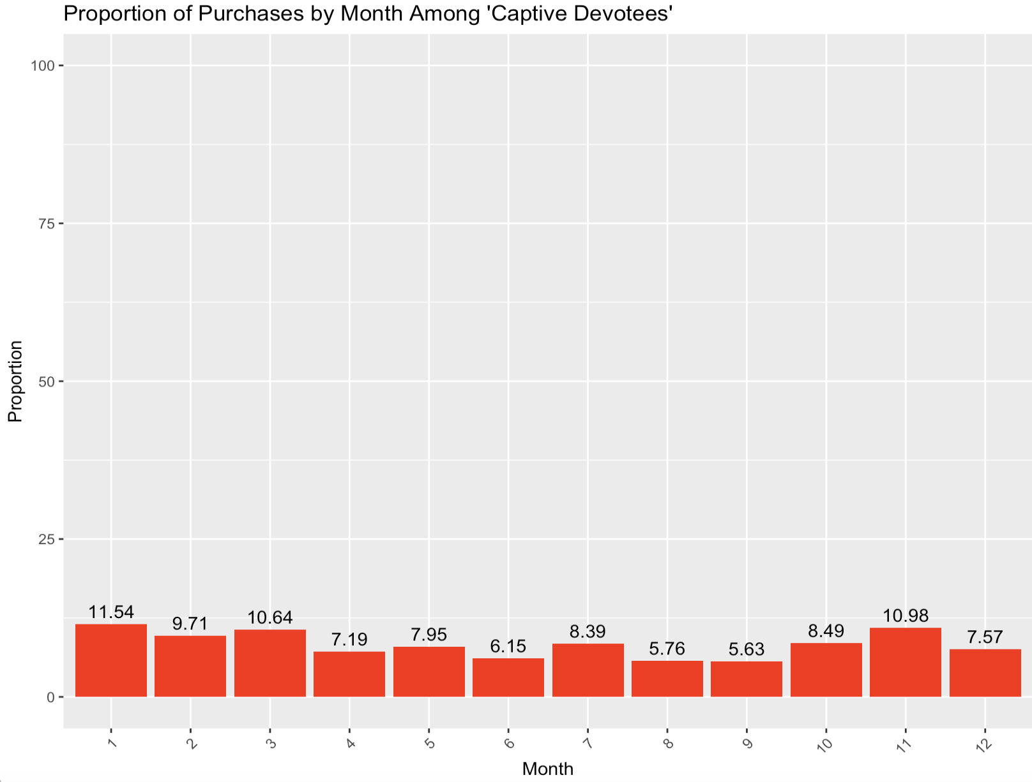
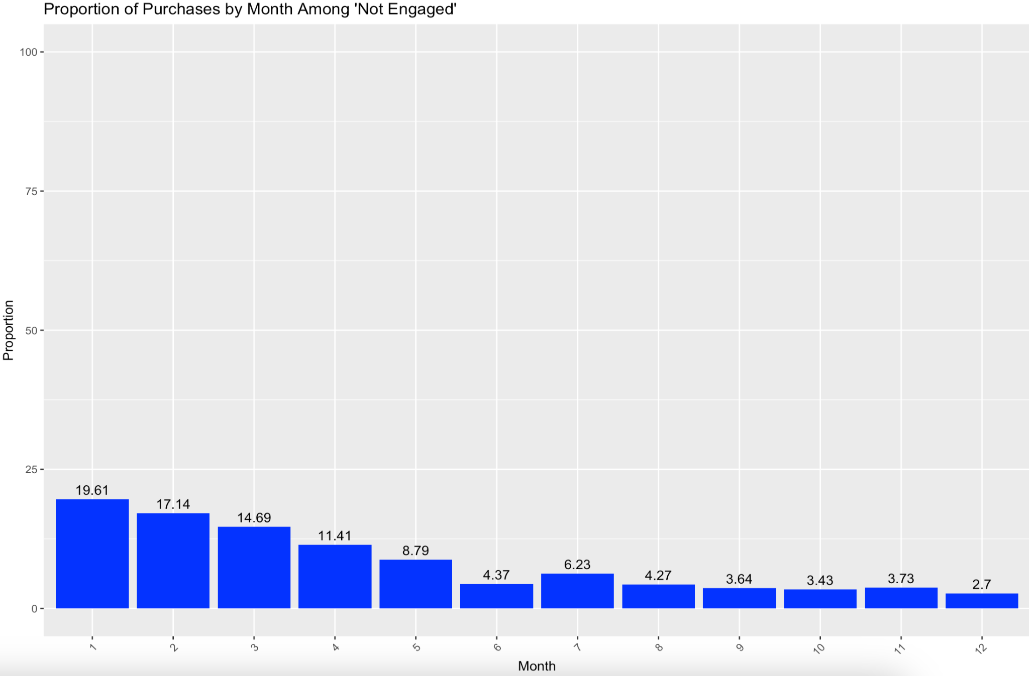
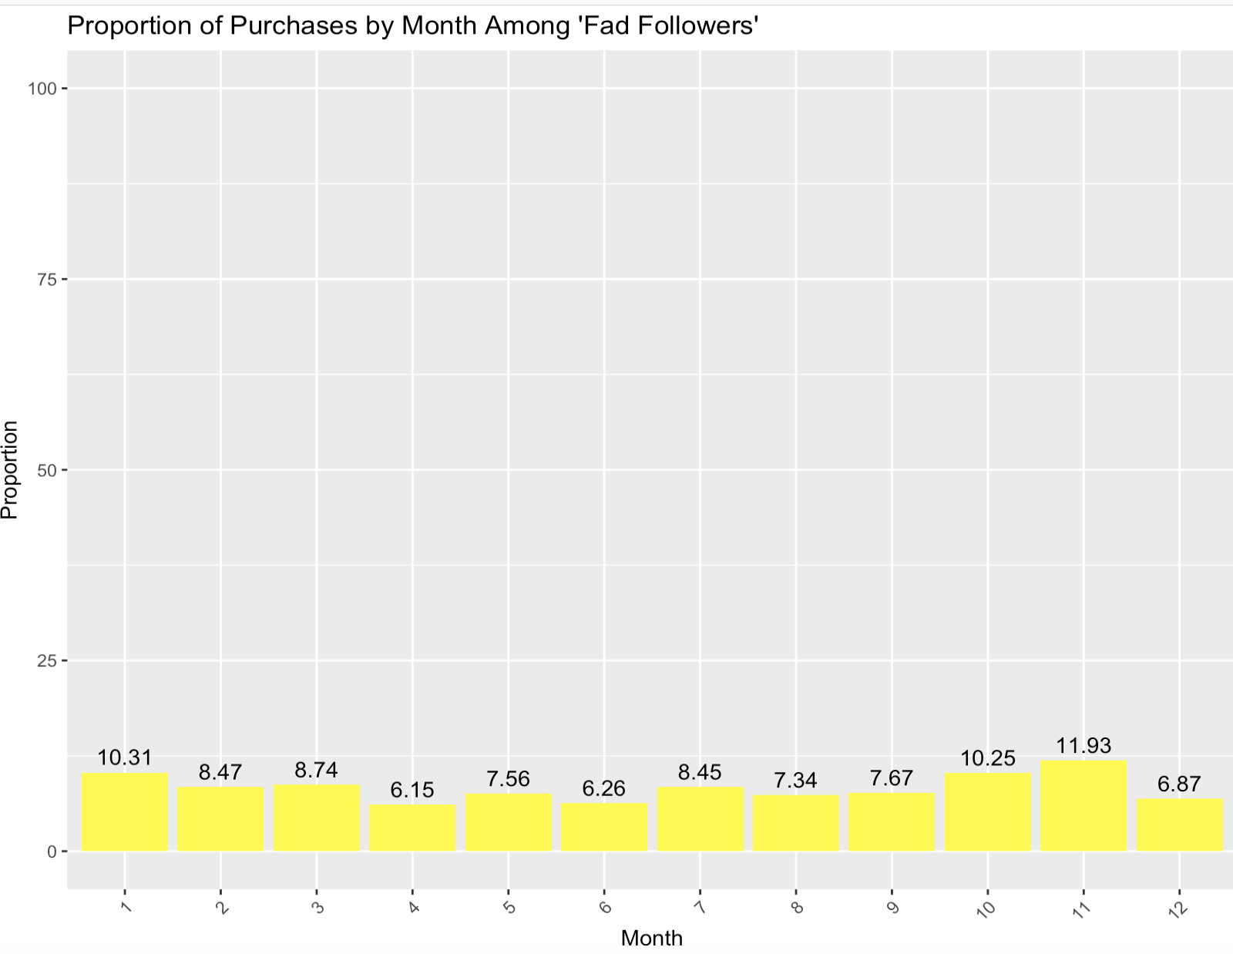
Customer Segmentation: By Month
Growth Customers
Captive Devotee
Not Engaged
Fad Followers

Slide 15
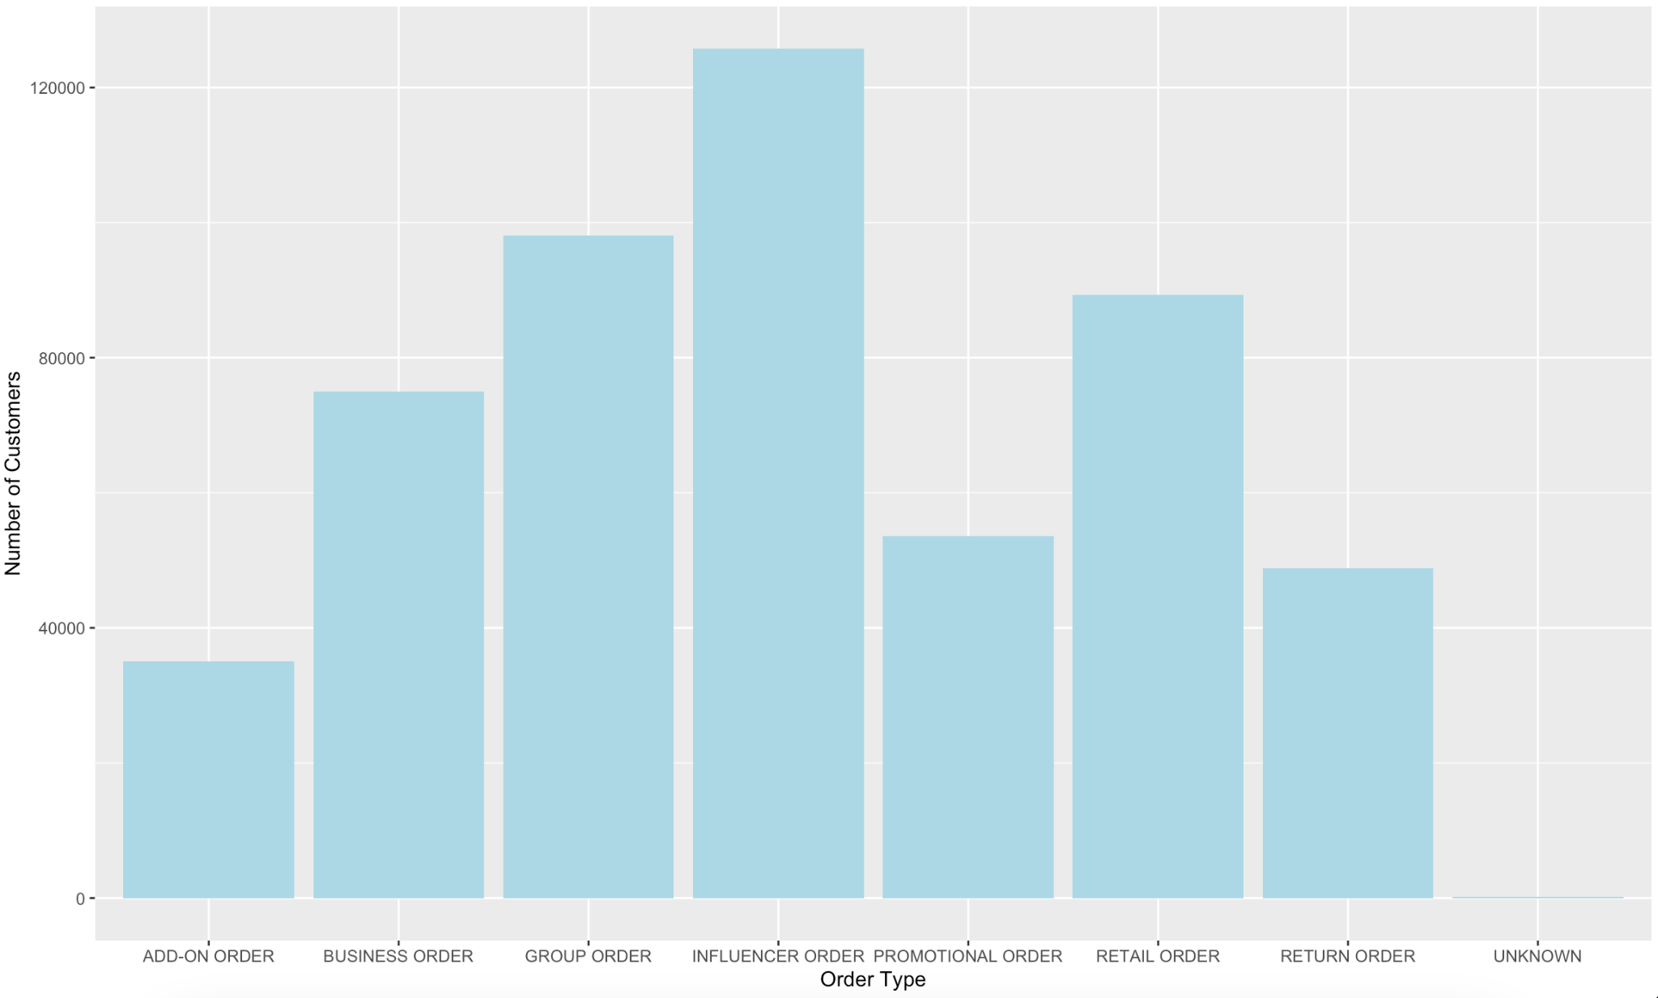
Breakdown of Order Types
Most customers place influencer order types.

Slide 16
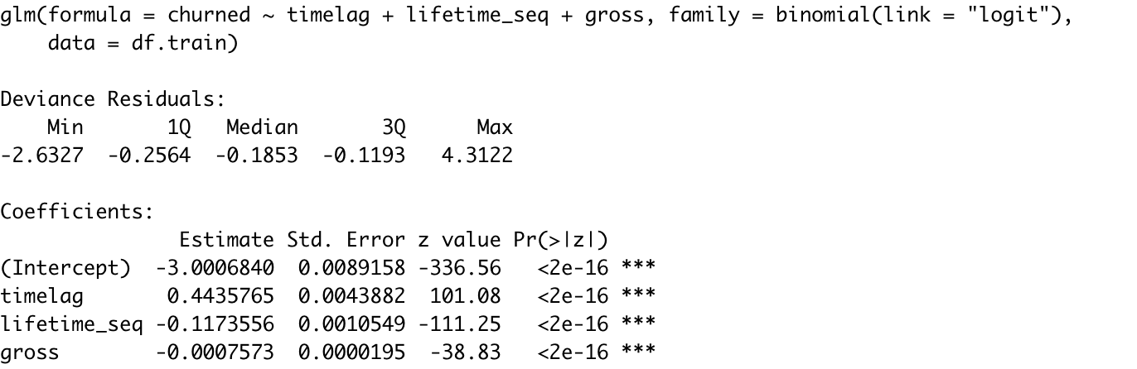
Factors That Impact CLV and Retention
Having a churn value closer to 1 indicates a customer is more likely to churn.
The churn value is inversely correlated with future CLV.
Thus it is in Coach’s best interest to decrease churn value to increase future CLV. To decrease churn value, Coach should focus on decreasing the time-lag for each customer.
Decrease timelag -> increase CLV -> increase Retention

Slide 17
Acquired brand customers are more down-market
Customer segmentation gives insight into how we could target different needs/wants
Most frequent transactions are of group order type
Largest number of customers place orders of influencer order type
Discussion
Notes:
Ayesah

Slide 18
Recommendations
01
02
03
04
Finance influencer promotion
Decrease the time-lag:
Subscription / newsletter
Pop up sales
Loyalty program
“Low-budget” luxury
Notes:
Looking at the coefficients for churn:
timelag 0.4435765
lifetime_seq -0.1173556
gross -0.0007573
We have seen from the customer segmentation by month that certain promotional methods work, so to decrease the time- lag and to see that spike we suggest subscriptions, newsletter,

Slide 19
Impact
Increased customer loyalty
Increased customer return rate
Building loyalty within the demi-brand through marketing will result in an increase of individual CLVs thereby shifting the spread of CLVs towards the right.
Having the demi-brand target a younger audience with less disposable income and establishing loyalty with them will make them more likely to become Coach buyers when they get older and have more disposable income to unlock a new customer lifecycle journey.

Slide 20
Thank you

Slide 21
References
coach.com Traffic Analytics, Ranking Stats & Tech Stack. (2023.). Similarweb. Retrieved September 25, 2023, from https://www.similarweb.com/website/coach.com/
Segment Analysis | COACH. (n.d.). COACH. Retrieved September 25, 2023, from https://coachinc.wordpress.com/assignment-2-part-2/segment-analysis/
Coach’s Pricing Strategies And Target Market. (2022, October 2).Yahoo Finance. Retrieved September 25, 2023, from https://finance.yahoo.com/news/coach-pricing-strategies-target-market-155102804.html?guce_referrer=aHR0cHM6Ly93d3cuZ29vZ2xlLmNvbS8&guce_referrer_sig=AQAAAGDV9QAbeuZd5ERAxm2bQrvqw5YJXCF2fS7tvipcvVnNoFFCZG42d6cMccPNFhMcPOxr-dnQ5WlDtuq4YSwu0loegyQlDewo7tV2rh8

